Slide 1
Task shift
Meeting in Iceland
5. September 2014
Marit Hermansen

Slide 2
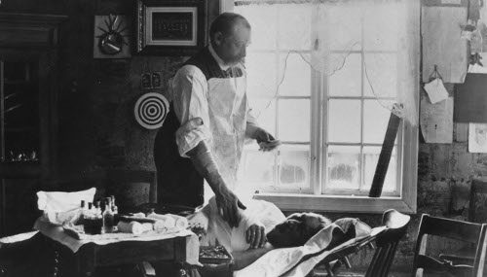
History

Slide 3

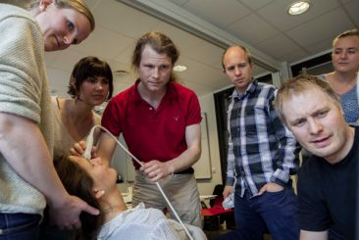
History

Slide 4
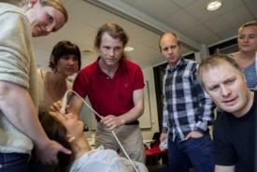

History

Slide 5
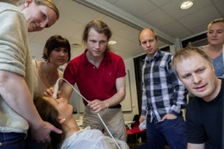


History

Slide 6
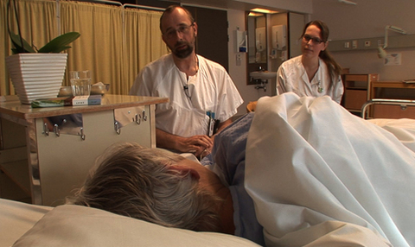

History

Slide 7
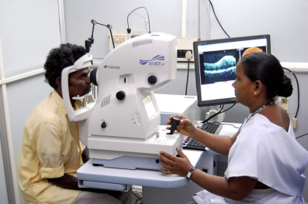
Definition of Task Shift
• a situation where a task normally performed by a physician is transferred to a health professional with a different or lower level of education and training, or to a person specifically trained to perform a limited task only, without having a formal health education.

Slide 8

Reasons
Development of the professions
Patient preference
Geography
Professional shortage
Politics
Money

Slide 9


Department of health

Slide 10

Department of health

Slide 11
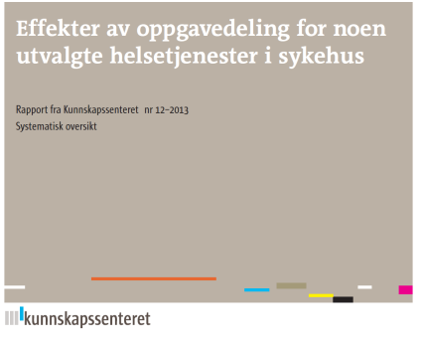
Task sharing for selected health services in hospitals
Endoscopy
Outpatient clinics
COPD
asthma
Cancer
Rheumatoid arthritis
Radiology
Pathology
Operating room nurses
Mercantile personnel
Notes:
The purpose of this systematic review was to summarize the effects of task sharing for some selected procedures in hospitals. For four of the six procedures, we found no evidence that met our criteria for inclusion. Based on evidence assessed as being from low to very low quality we draw the following conclusions for two of six questions:
What are the effects of task sharing between doctors and nurses for patients undergoing endoscopy?
● There may not be large differences for patient outcomes such as: pain/discomfort, gastrointestinal symptoms and quality of life. For the outcomes: need of assistance, duration, number of polyps missed, depth of sigmoidoscopy, number of biopsies, immediate complications and costs we cannot, on the basis of the evidence, determine whether there are important differences between endoscopy performed by nurses or by doctors.
What are the effects of task sharing between doctors and nurses for patients followed up in outpatient clinics?
● Patients with bronchiectasis: there may not be large differences in quality of life or the number of hospitalisations per patient. However, it is possible that there may be greater costs associated with the use of nurses. For the outcomes: lung function, lung capacity, exacerbations due to infection and training capacity we cannot, on the basis of the evidence, determine whether there are important differences for patients between follow-up
by nurses or by doctors.
● Patients with asthma: there may not be large differences in quality of life, hospitalisation per patient or costs. For outcomes: number of symptom-free days, lung function, number of medication-free days, maximum air flow or the number of exacerbations we cannot, on the basis of the evidence, decide whether there are important differences for patients between follow-up by nurses or by doctors.
● Patients with rheumatoid arthritis: patient satisfaction may be somewhat improved due to follow-up by nurses rather than rheumatologists. For general health outcomes: joint pain, fatigue, global assessment of disease activity and disease activity measured by DAS 28 it is possible that there are no large differences between follow-up by nurses or by rheumatologists.
● Adults with cancer: nurses may use more time on consultation and take more blood tests, but there may not be large differences for patient satisfaction if cancer patients are followed up by a doctor or nurse. For the outcomes: mental health, depression, occurrence of metastases or overall costs we cannot, on the basis of the evidence, decide whether there are important differences for patients between follow-up by nurses or doctors.

Slide 12
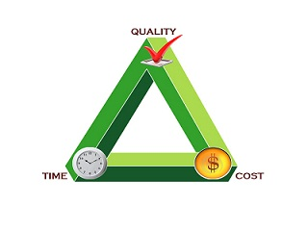
What about the quality?
no reduction accepted
-but sensible use of resources
use of time
supervision

Slide 13

Between levels
And what about the primary health care?
Education
Specialization
Professional shortage
Mercantile personnel
Decentralized care

Slide 14


Task dropping?

Slide 15

New challenges
From specialist to GP
Agreements
Supervision
Communication
Cooperation

Slide 16

New challenges
Nurse practitioners
Nurses!
Health care assistants
Pharmacies
Psychologists
The web
Network
Empowerment
From GP to……

Slide 17

GROUP sessions
the Nordic countries
What is a team in primary health care?
At the GPs office
In home based care
How to secure collaboration around patients with complex needs?

Slide 18
Group session

