Slide 1


Health care reform
Finland 2014-2016
Into Action1.1.2017
Arto Virtanen
Reykjavik 4.9.2014

Slide 2
New legislation
The ministry released their suggestion for public discussion 18.8.2014
Time for discussions and opinions up to 14.10.2014

Slide 3
Healthcare and social care now
Municipalties arrange themselves or together with other municipalties
  all healthcare and social care
    Social and health are in different silos
Primary care often themselves
Secondary care mostly together with neighbours
Result:
  Wide variation in quality, costs, methods used, availability of care….

Slide 4
Healthcare after the reform
Integrated with social care
Country divided into 5 social-healthcare areas, average 1 mill inhabitans
  Areas financed by municipalities
  All care financed by the areas
Decision-making and organizing by these areas (in their own geographical areas)
Social-healthcare areas themselves are forbidden to produce (run hospitals etc)
Producing monopoly for the public sector
  Same municipial producers as before
  Private sector may be used as a secondary suplier

Slide 5
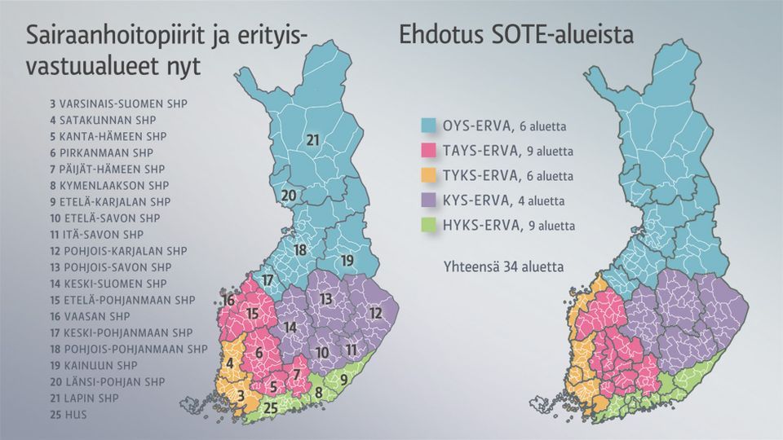
Hospital-areas 2014
& Municipalities
Notes:
Nyt = Now;
colours = University-hospital districts
Numbers = Central hospital distircts
White lines: Municipalities
Ehdotus: Suggestion for the coming health-care areas

Slide 6
State Guidance
Ministry of health & social affairs
Finances & Decisions
Social-Health area
Social-Health area
Social-Health area
Social-Health area
Social-Health area
Producers
City
City
City
MP
City
City
MP
MP
City
MP
MP
MP
City
City
City
MP
MP
MP
MP
MP
City
MP
MP
MP
MP
MP
MP
MP
MP
MP
MP
MP
MP
MP
MP
MP
MP
MP
MP
MP
MP
MP

Slide 7

State Guidance
Ministry of health
Finances & Policymaking
Social-Health area
Social-Health area
Social-Health area
Social-Health area
Social-Health area
Social-Health area
Producing responsibilty
City
City
MP
City
City
MP
City
City
MP
MP
MP
MP
City
MP
City
City
MP
MP
MP
MP
MP
MP
City
MP
MP
MP
MP
MP
MP
MP
MP
MP
MP
MP
MP
MP
MP
MP
MP
MP
MP
MP
Central
Hospital
Central
Hospital
Central
Hospital
Central
Hospital
Central
Hospital
H Center
H Center
H Center
H Center
H Center
H Center
H Center
H Center
H Center
H Center
H Center
H Center
H Center
H Center
H Center
H Center
Hospital
H Center
H Center
Hospital
H Center
H Center
H Center
H Center
Hospital
H Center
Hospital
Hospital
Hospital
Hospital
H Center

Slide 8
Municipality-view
Social-Healthcare area
Finance from the municipalities
Decision making
Now
Then
City / Cities
take care
City / Cities
take care
City/Cities
Produce
City/Cities
Produce
City/Cities
Produce
City/Cities
Produce
Central Hospital
Central Hospital
Hospital
Hospital
Hospital
Hospital
Hospital
H Center
H Center
H Center
H Center
H Center
H Center
H Center
H Center
H Center
H Center
H Center
H Center
H Center
H Center
H Center
H Center
H Center
H Center
H Center
H Center
H Center

Slide 9
Municipality
Social-Health - Area
Municipality
Municipality
Policy &
Resources
Municipality
Municipality
Health care
Health care
Current healthcare
Health care
Health care
Health care
Municipality
Municipality
Health care
Municipality
Policy &
Resources
Policy &
Resources
Health care
Health care

Slide 10
Social-Health Area Government
Representatives must be counsellors in the municipalities
Every 4 years each area must make a new ”gameplan” about the ways of working
In the area municipalities have the votepower:
  Depending on the number of inhabitants
  1 city cannot have over 50% of power.
Once a year the ministry of health and social affairs has official talks with areas

Slide 11
Area decides
Define needs for services
Implement national strategies
  Social- healthcare – integration
  Near – services must be arranged too
  Emergency services
Define ways of providing services
The area is responsible for health care records
How to obtain private-sector subcontractors
Controlling and measuring services provided
Citizens may be heard in the decisionmaking process

Slide 12
Municipalities and hospitals
Produce services
  The social-healthcare area decides what services will be produced and where and how they will be produced

Slide 13
Our Worries
Larger municipalities will dominate
  Will rural health care survive ?
Local near-services = e-health self service
One more level of gorvernment
Still no financial reform
  Nobody is responsible for the total cost of healthcare
  Drugs, transport, hospitals, social costs, housing, sick-leaves
    most of these all financed by different sectors of the society

